Slide 1
Project : Rating PREDICTION
By R. Rajesh Kannan

Slide 2
Problem: We have a client who has a website where people write different reviews for technical products. Now they are adding a new feature to their website i.e. The reviewer will have to add stars(rating) as well with the review Now they want to predict ratings for the reviews which were written in the past and they don’t have a rating. So, we have to build an application which can predict the rating by seeing the review

Slide 3
Data collection
Here we have to scrap data from e-commerse websites like amazon and flipkart.
I used selenium as a web scraping tool.
Totally I scrap over 20000 data nearly a equal number of reviews for each rating.
Then save data frame as csv file for further process.

Slide 4
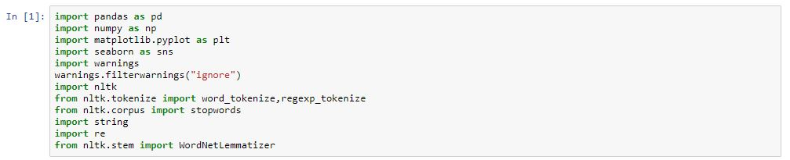
Import Libraries and read the data
Have to import the required libraries that we are going to use.
Have to read the data with pandas library

Slide 5
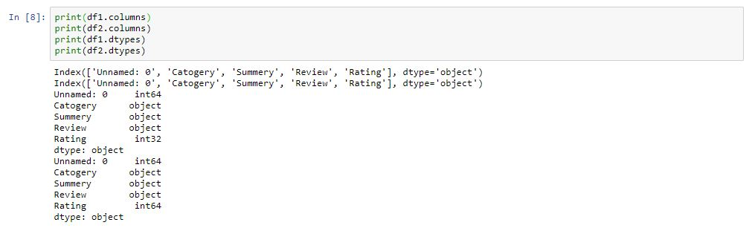
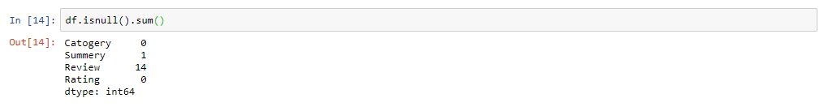
EDA Process: Checking of data type and presence of null values :
Data Type may,
Int
Float
Object
There are presence Null values with minmum percentage in some column.
Drop of null value will not affect.

Slide 6
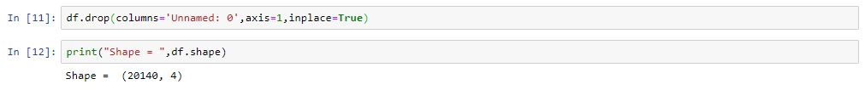
Treat of unnecessary data and columns
Remove Unnamed: 0 because all value it contain are unique.

Slide 7
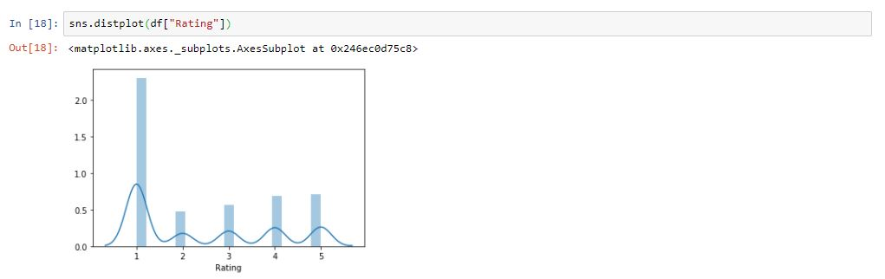
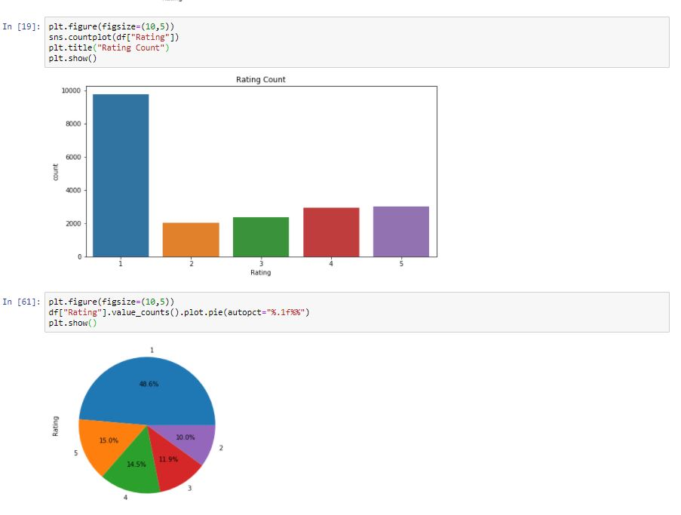
Visualization
Uni variant visualization:
Distribution of Rating:
It shows good distribution but little imbalance in data.
Count plot in Rating:
It shows number of count the rating in data set.
The pie graph shows the percentage for rating count.

Slide 8
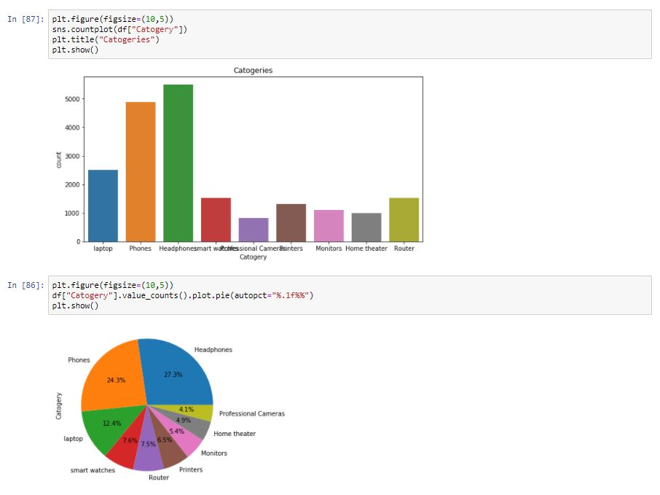
Count plot in Category:
It shows number of count the the given category of product occur in data set.
The pie graph shows the percentage for different product count.

Slide 9
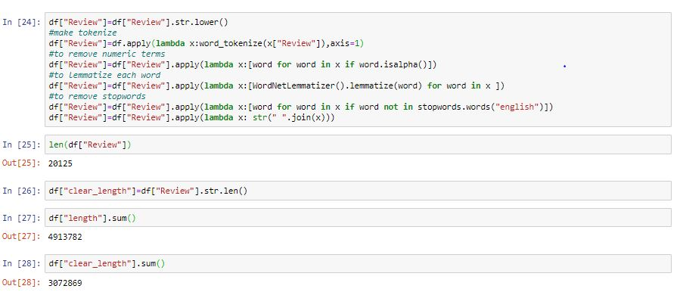
Pre-Processing Text Data
Apply preprocessing skills to get the text data clean by remove the junks like punctuation, stopwords, numbers etc. and the train and predict the model.
With the help of NLTK we can do this process to remove junk values

Slide 10
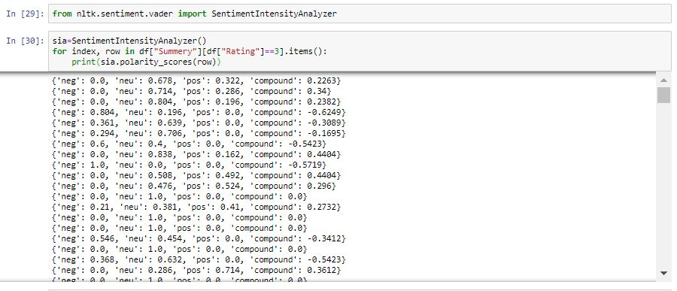
Sentiment Analyzer
Sentiment Analyzer is done by apply Sentiment Intensity Analyzer on pre processed text data
Polarity score which shows that negative, neutral and positive score based on that score the data will consider it is positive or negative.

Slide 11
vectorizer
We can not able to input data as text format so we have to convert it to vector for text data for make it as input.

Slide 12
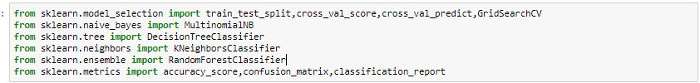
Model Selection and import
In Superwised ML there are classification and regression models. But here output variable have only five classification values, so it will come under classification model.
Import the required model from sklearn library
Due to presence of text data as input we have to covert text to vector then to numeric as for model understanding.

Slide 13
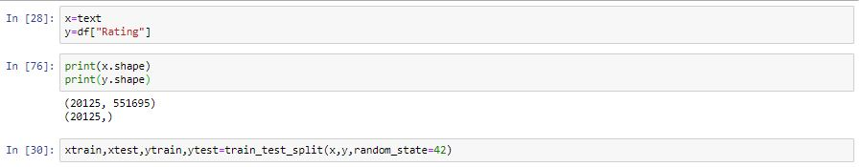
Splitting of data
Have to split the data as input train and test, output train and test.
Here train input is Review, train output is Rating.
After the selection the best random state we have to find best model by getting good accuracy score, through train and test the data

Slide 14
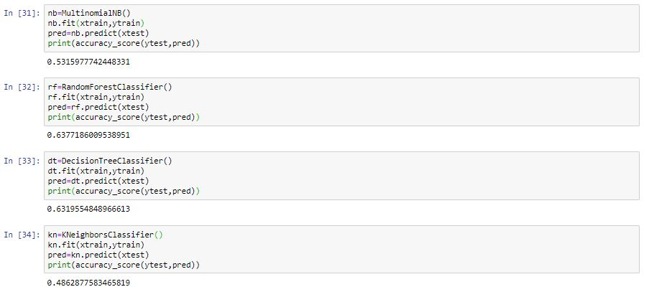
Model fitting and prediction
Firstly have to fit the model,
Secondly have to train the input and output data in the respective models.
Have to check the score and select the best model by its score.
Then have to predict by test input data to get Rating as output.
By accuracy score we came to know it’s a good model or not.

Slide 15
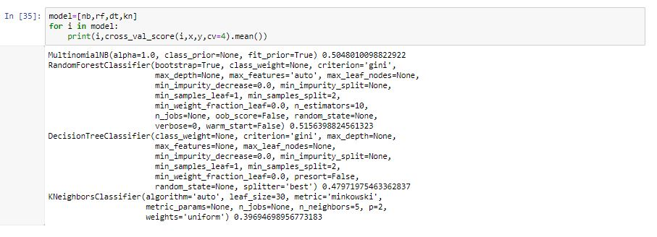
Model Prediction
Not only by above process we can find the best model because there may occur over fitting due to presence of high bias and high variance in it. So we have to do Cross Validation on it for right result.
So these models in the list have to iterate through cross validation.
From above MultinomialNB is consider as a good model when compare with other.

Slide 16
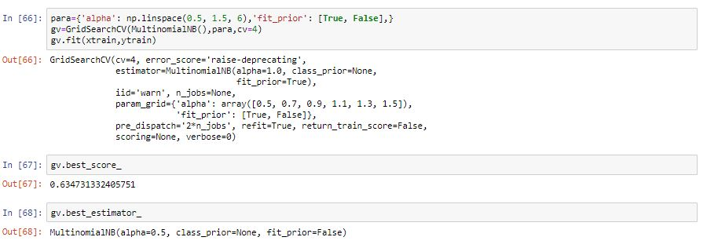
Hyper Parameter Tuning:
Fig1 For to improve the accuracy score for selected best model or all model, we have to apply Grid Search or Randomized search, by apply all the required parameters of respective model inside Grid Search we can get better accuracy.
MultinomialNB gives a better result at 63%.
And also came to know the best parameters .
Fig2 Predict the review data for test input by fit train data in MultinomialNB model.

Slide 17
Finalized model
By compare the difference between Cross Validation Score and accuracy score we can select the less difference model as best and also consider its score after did Hyper Parameter Tuning.
If the model best score is high it will consider as better model ,if it is low it will not consider as good model
MultinomialNB model is come under the above constrains.

Slide 18
Conclusion:
It concluded that there is some junks in test data. By treat it and prediction was lead to get good model with 63 % as best score.
Observed data through visualization.
As the end we can Predict the Ratings for Reviews as input by fit train data in the model with good score.

